Slide 1
Lesson 4: Using Copilot in PowerPoint and Beyond

Slide 2

Meet Your Presenter
Khalaf Haddad
Principal, Imua Learning
Over three decades of Technical Training, Leadership and Professional Development Experience
Published Author
Interests: History, General Aviation, Distance Running
Fun Fact: Khalaf and his wife are enjoying their first grandchild born in April 2024!

Slide 3
Pearson’s Copilot Training
Connecting the dots across Pearson’s AI Strategy

Slide 4
Phase 2 – Application Training
Lesson 1: Writing Prompts for Copilot
Lesson 2: Copilot in Outlook and Teams
Lesson 3: Copilot in Word and Excel
Lesson 4: Copilot in PowerPoint and Edge
Discover the art of creating effective prompts for Copilot.
Learn to work with Copilot’s capabilities in Outlook and Teams.
Learn to work with Copilot’s capabilities in Word and Excel.
Learn to work with Copilot’s capabilities in PowerPoint and the browser.

Slide 5

Badges

Slide 6
Outline
1
Copilot in PowerPoint
2
Copilot Analyst and Researcher
3
Course Completion Badges

Slide 7
Copilot in PowerPoint

Slide 8

Content Generation
Automatically draft slides from prompts or documents
Summarize long text into concise bullet points
Create detailed speaker notes efficiently
Notes:
Copilot can help streamline your slide creation by automatically drafting content based on your prompts or documents. It also summarizes lengthy texts into brief bullet points and generates comprehensive speaker notes, saving valuable preparation time.

Slide 9

Design Assistance
Suggest appealing layouts and visual styles
Apply consistent themes and branding across slides
Recommend relevant imagery and icons
Notes:
Enhance your presentations with Copilot’s design assistance. It suggests slide layouts and visual styles that fit your content, ensures consistent application of themes and branding, and helps select appropriate imagery and icons to boost visual appeal.

Slide 10

Data Visualization
Convert raw data into clear charts and graphs
Suggest suitable visual formats for data
Integrate dynamically with Excel for updates
Notes:
Copilot simplifies data visualization by transforming raw data into clear and informative charts and graphs. It recommends the best visual formats and integrates with Excel to keep your visuals updated dynamically.

Slide 11

Real-Time Editing Support
Rewrite or rephrase slide content for clarity
Improve tone and style to engage audiences
Translate text into multiple languages seamlessly
Notes:
Receive real-time editing support with Copilot. It can rewrite or rephrase your slide content to improve clarity and tone, ensuring your message resonates. Additionally, it translates content into different languages to reach diverse audiences.

Slide 12

Presentation Coaching
Get feedback on pacing and delivery
Identify filler words and tone inconsistencies
Receive suggestions to boost audience engagement
Notes:
Copilot also acts as your presentation coach by providing feedback on your pacing and delivery. It highlights filler words and tone issues, offering actionable suggestions to make your presentations more engaging and effective.

Slide 13
What Copilot in PowerPoint Can and Can’t Do
Feature | ✅ What Copilot Can Do | ❌ What Copilot Can’t Do (Yet)
Slide Creation | Generate slides from prompts or outlines | Design highly customized slide layouts or animations
Content Drafting | Write speaker notes, bullet points, summaries | Replace deep subject-matter expertise or storytelling nuance
Design Suggestions | Recommend themes, layouts, and visual styles | Match specific brand guidelines or advanced design systems
Image & Icon Insertion | Suggest relevant visuals, icons, and stock images | Create original graphics or logos without external tools
Data Visualization | Create charts and graphs from text or data | Customize chart styles beyond basic options
Summarization | Summarize long sections or entire documents | Summarize embedded images, charts, or scanned content
Tone & Style Adjustments | Make text more formal, concise, or persuasive | Match highly specific brand voice or legal tone
Collaboration | Suggest edits and comments | Track changes with full context like a human reviewer
Creativity | Generate ideas, outlines, or content drafts | Replace human creativity in storytelling or persuasive writing
Accessibility Enhancements | Recommend alt text and readable layouts | Guarantee full compliance with accessibility standards

Slide 14
Copilot Analyst and Researcher

Slide 15
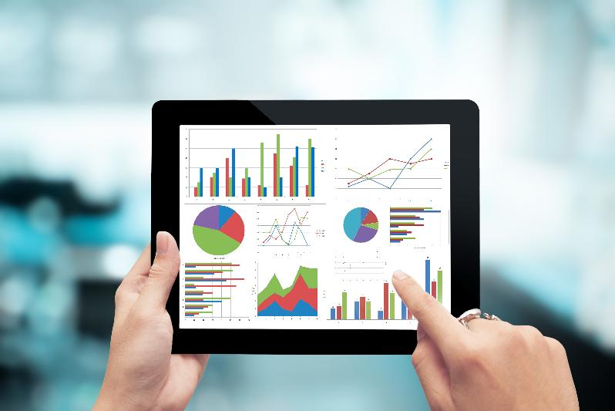
Copilot Analyst
Automates data analysis
Generates visualizations
Identifies trends and patterns
Facilitates scenario modeling and dynamic reporting
Notes:
Copilot Analyst enhances data handling by automating complex analyses, crafting clear visualizations, and identifying meaningful trends. It supports users by suggesting formulas, troubleshooting errors, and enabling scenario-based forecasting and reporting, thereby boosting productivity and accuracy in data-centric tasks.
Automates data analysis to uncover key insights efficiently.
Generates visualizations like charts and graphs from raw data.
Identifies trends and patterns to support decision-making.
Suggests and optimizes formulas for accurate calculations.
Helps troubleshoot errors for smoother data processing.
Facilitates scenario modeling and dynamic reporting.

Slide 16

Copilot Researcher
Gathers research materials.
Generates well-structured outlines and content drafts.
Offers citation and reference management support.
Notes:
Copilot Researcher streamlines the research process by collecting and summarizing data from multiple sources. It aids in drafting content, organizing citations, improving document clarity, and facilitating collaboration, making academic and professional research more efficient and effective.
Assists in gathering and summarizing relevant research materials.
Synthesizes information from diverse sources quickly and accurately.
Generates well-structured outlines and content drafts.
Offers citation and reference management support.
Enhances clarity and coherence of research documents.
Supports collaborative review and iterative improvements.

Slide 17
Claiming Your Badges

Slide 18
Badges

Slide 19
Section title
How to Claim Your Badges
Microsoft Badge:
URL:
Pearson Badge:
URL:
Copyright 2025 Pearson. All rights reserved.

Slide 20
Thank You!

